Slide 1
Starting Your Own Virtual Accounting Company – Session 1: Systems & Technologies

Slide 2
Setting Up Your Home Office: Equipment
Home Office Equipment:
Computer (Laptop)
Dual Monitors
Scanner & Printer
High Speed Internet
Get the fastest speed available. Avoid satellite internet
Headset
Optional:
Wireless Keyboard & Mouse
Portable Office/ Ready to Go Bag

Slide 3
Setting Up Your Home Office: Back Up Plan
What if your internet goes down, power goes out, or construction outside your home office window??
Have a Back-up Plan!
Wireless Hotspot
Know your local internet options for your backup plan
Scout out local coffee shops, libraries, and friends houses
What service do they use?
Are there areas you can work there on confidential client call?

Slide 4
Setting Up Your Home Office: Equipment Maintenance
Up to Date Malware / Anti-Virus Software
Hard Schedule Monthly on Your Calendar Computer Clean-up
Regular Scans
Remove Unused/Temporary Files
Check Status of Anti-Virus/ Malware Software
Hard Schedule Monthly on Your Calendar Computer Backups
Save task list, contacts, documents on your local computer to Cloud9

Slide 5
Communication Tools: Phone System
Recommended Phone System: VOIP
My current provider: Vonage
Features of VOIP:
No Hard Line – Use Fee Software Download
Mic/Speaker Options – Laptop, USB Headset, Wireless, Bluetooth
Anytime/anywhere w/ internet access/laptop
Routing to Cell Phone
Consistent company numbers + Main line w/ extensions
Easy to add/remove users
Voicemail to email
Conferencing
Unlimited local/long distance. No hidden cost. No contract term. $19.95/line/month.
Easy to add/remove users

Slide 6
Communication Tools: Email
Worksite email that can add staff users as you go
My current provider: Rackspace
Email Management Recommendation: Outlook
Tasks, Calendar, Scheduling

Slide 7
Communication Tools: Fax
Recommended Fax System: E-Fax Services
My current provider: MaxEmail / Vonage
Features of E-Fax:
No Hard Line – Use Fee Software Download
Faxes Received in Email
Client can auto program fax to our document management site

Slide 8
Communication Tools: Online Meetings
Recommended Provider: GoToMeeting
Features:
Screen Sharing
Change Screen View/Presenter
Phone Conferencing (Dial in or Mic/Speakers)
Video Conferencing
Recording
Chat

Slide 9
Accounting Software/Hosted Server
QBOnline vs QB Desktop vs Client Server
QB Desktop current provider: Cloud9
Cloud9 Beyond QB Hosting:
Integrated Apps Hosting
Document Storage & Sharing
Permanent Files
Shared Staff Files at Tiered Levels
Hosting by Tax CPA’s
Copy/Paste To/From Local
Printing to Local
Storage of ALL items from Local in the event of computer issues

Slide 10
Workflow Management System: Cloud9 Workflow
Current Provider: PaperlessOvernight.net
Client Receives Source Document (Bill, Statement, POS Report, etc.)
Document Received and "Named" by DOT (document technicians)
DOT Sends to Data Entry Technician
Client Scans/Emails Document to Assigned WMS Email Address

Slide 11
Workflow Management System: Cloud9 Workflow
Data Entry Technician Enters Transaction to QuickBooks
Accountant Can: Close; Send Back to Tec; Send to Client for Clarification
Document Sent up WorkFlow Line
Data Entry Technician Sends To Accountant for Review

Slide 12
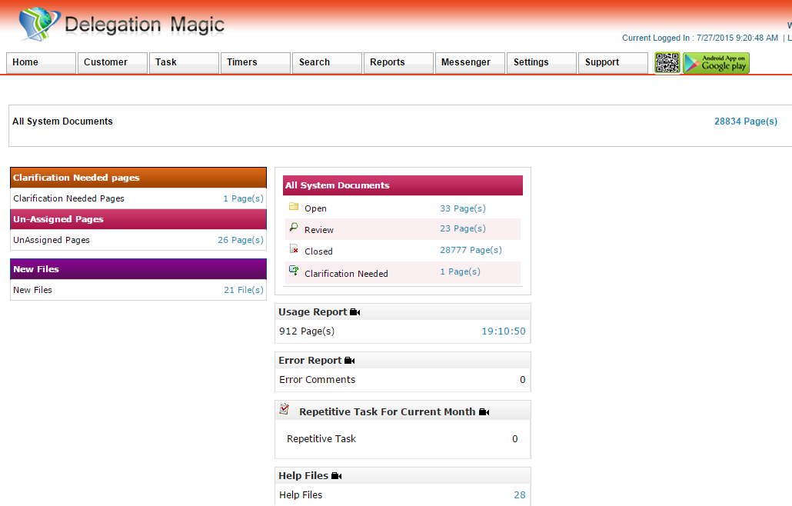
WorkFlow Management System: Home Page

Slide 13
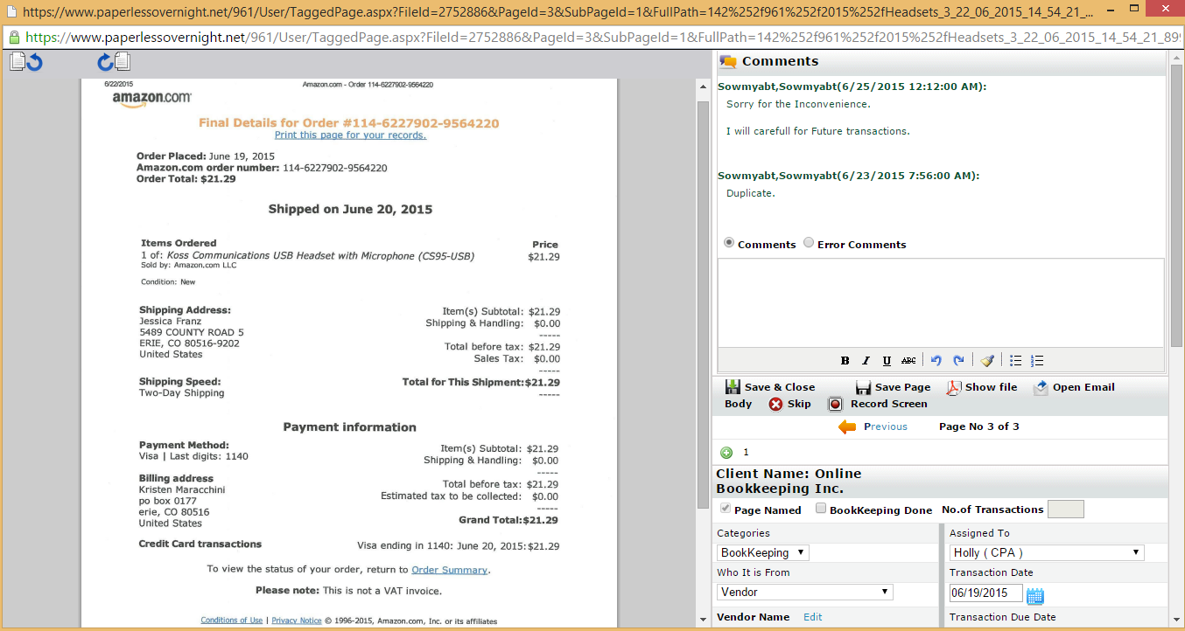
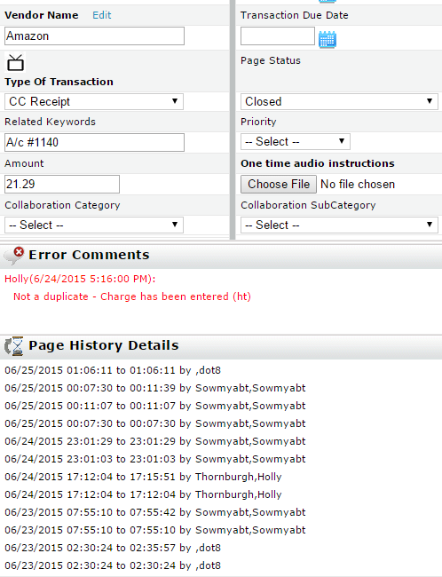
WorkFlow Management System: Document

Slide 14
WorkFlow Management System: Other Features
Other Features in PaperlessOvernight.net
Help Files
Repetitive Task
Search Function
Error Report
Correspondence (Permanent) & Payroll (Confidential)

Slide 15
Other Applications
Other Applications to Consider:
Time Entry: SpringAhead
CRM: Method
Import Tool: Zed Axis
Electronic Bill Pay: Bill.com; Bill & Pay
Electronic Banking: Intuit Bank Feeds

Slide 16
Q&A

